Slide 1
Employee Performance Analysis
Performance, Training, and Feedback Overview
Date : 10 Nov 2024
Created By : Omkar Abhyankar

Slide 2
Agenda
Introduction
Data Overview
Performance Analysis
Training Impact
Feedback Insights
Recommendations
Conclusion

Slide 3
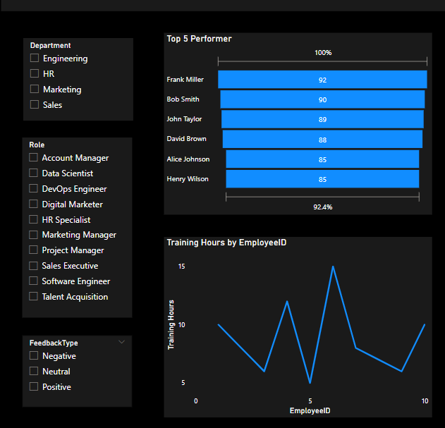
Introduction to Employee Data
Alice Johnson (Software Engineer) – Engineering Department, hired 2020-01-15.
Bob Smith (Marketing Manager) – Marketing Department, hired 2019-03-20.
Irene Martinez (Account Manager) – Sales Department, hired 2019-08-05.
Frank Miller (Engineering) – Data Scientist, Hired 2020-09-15

Slide 4
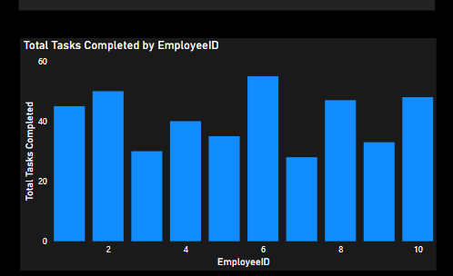
Performance Analysis
Top Performers:
Frank Miller (92% completion, 30 hours of training, satisfaction 4.9)
Bob Smith (90% completion, 15 hours of training, satisfaction 4.7)
Areas for Improvement:
Eva Green (75% completion, 18 hours of training, satisfaction 4.1)
Irene Martinez (77% completion, 20 hours of training, satisfaction 4.0)

Slide 5
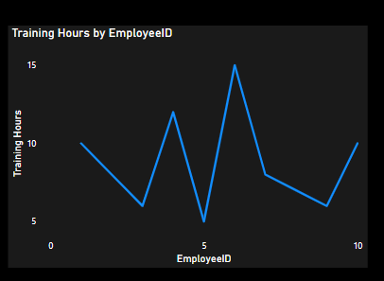
Training Impact
Training Overview:
Employees participated in various programs like Agile Methodologies, Cloud Computing, Data Analysis, etc.
Frank Miller (15 hours of Data Analysis training).
Eva Green (5 hours of Sales Techniques).
Training Impact on Performance:
Employees with more training hours tend to have higher satisfaction scores and better project completion rates (e.g., Frank Miller vs. Eva Green).

Slide 6
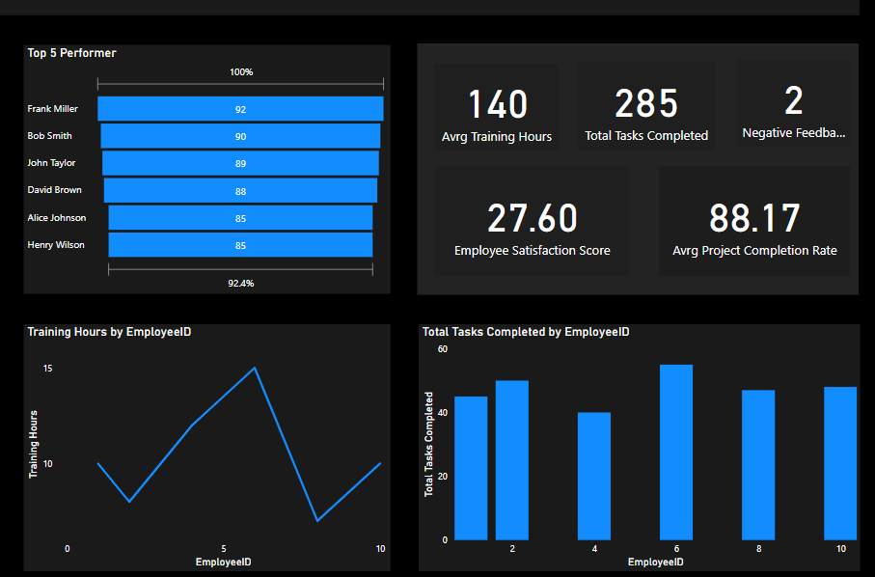
Feedback Insights
Feedback Summary:
Positive Feedback: Most employees received positive feedback (e.g., Frank Miller’s "Exceptional analytical skills").
Neutral Feedback: Some employees need minor improvements (e.g., Carol Williams on time management).
Negative Feedback: A few employees received negative feedback (e.g., Eva Green on client engagement, Irene Martinez on conflict resolution).
Example Data:
Positive: Frank Miller (exceptional analytical skills), John Taylor (strong project management).
Negative: Eva Green (needs more client engagement), Irene Martinez (needs work on conflict resolution).

Slide 7
Recommendations
For High Performers (e.g., Frank Miller):
Continue providing advanced training opportunities.
Recognize their contributions and maintain motivation.
For Low Performers (e.g., Eva Green, Irene Martinez):
Offer additional training in specific areas (e.g., client engagement for Eva, conflict resolution for Irene).
Provide mentorship or coaching to improve feedback areas.
General Recommendation:
Increase training participation across all employees to enhance overall performance and satisfaction.

Slide 8
Conclusion
Summary: Employee performance is highly correlated with training hours and positive feedback.
Focus on continuous development for all employees.
Address feedback issues with targeted training or coaching.

Slide 9


